Slide 1



Slide 2
RFID
Radio Frequency
Identification
Notes:
<number>

Slide 3

Topics covered
Definition of RFID
Working Components
Active/Passive RFID
Frequency
Advantages/Disadvantages
Applications
Future
Conclusion

Slide 4
What is RFID?
Radio Frequency Identification is an identification system used for retail and wholesale, security, veterinary, and military purposes. The RFID technology sector is growing rapidly as new uses for it are found.
Technology used to track and identify a person or object by means of radio transmission
RFID systems can be either active or passive.
You may be surprised to find that you have been using RFID technology for years without knowing it.

Slide 5
How does RFID work?
Three main components to a basic RFID system:
RFID Tag (transponder)
Antenna
RFID Reader (Interrogator)

Slide 6
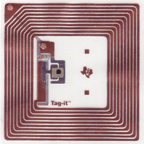
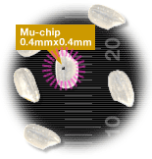
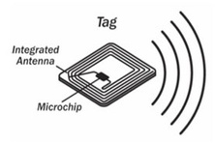
How does RFID work?
RFID Tag (Transponder)
Consists of a microchip and an antenna
Attached to an object to be tracked (vary in size)
Stores information about the object (ID number, kilobytes, dynamic info maintained)
Read only or read/write
Contact-less, Non-line of sight
Read Range: few inches to hundreds of ft.

Slide 7
How does RFID work?
Two classes of RFID Tags, Passive and Active, based on the means in which they receive power:
Passive
Power source is provided by the RFID Reader’s generated field
Smaller size tags, must be within close range of reader (~ 2m)
Active
Have an internal power source
Larger, more expensive, shorter life
Longer reading ranges, more memory

Slide 8
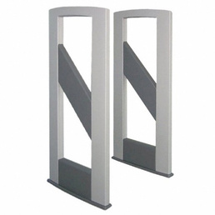
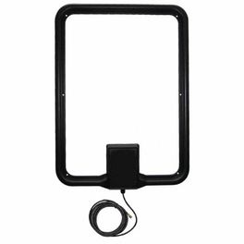
How does RFID work?
Antenna
An antenna (or aerial) is an electrical device which converts electric power into radio waves, and vice versa. It is used for communication between reader and tags.

Slide 9

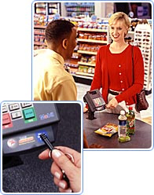
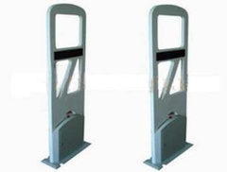
How does RFID work?
RFID Reader (Interrogator)
Retrieves information from the RFID Tag
Detects/Activates tag, reads and writes data to tag
May consist of a signal processor, operating system, antenna, virtual memory, and transmitter/receiver unit
Active or Passive

Slide 10
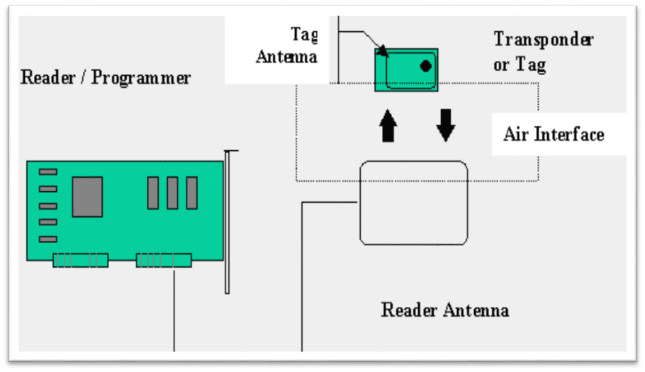
How does RFID work?

Slide 11
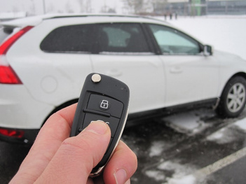
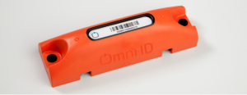
Active RFID
Active RFID devices are RF tags with an attached power supply. These tags emit a signal whether or not there is an antenna in the vicinity to receive the data.

Slide 12
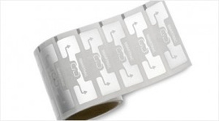
Passive RFID
Passive RFID devices are RF tags that do not have an attached power supply. The passive RF tags receive their power when it is emitted from active antennas in close proximity.
Passive RFID tags generally operate at three distinct frequencies:
Low Frequency (LF) 125 -134 kHz
High Frequency (HF) 13.56 MHz
Ultra High Frequency (UHF) 856 MHz to 960 MHz

Slide 13
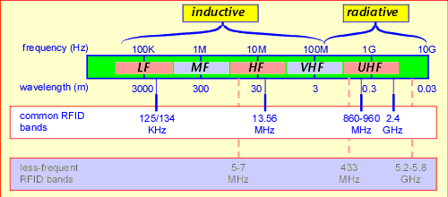
Frequency

Slide 14
Advantages
An RFID system is the noncontact, non-line-of-sight nature of the technology.
It enhance Efficiency ,traceability of production.
Hundred of tags can be read in seconds.
They can be combined with sensors.
It not only saves time but also provides real time information & data access to anybody.
RFID tags can store a lot of information, and follow instructions
Has the ability to pinpoint location
Reliability.

Slide 15
Disadvantages
Active RFID can be expensive because of batteries.
There still needs to be regulations about RFID guidelines.
There is a privacy concern towards RFID devices, for example some claim that Wal-Mart is infringing on natural rights by overseeing what customers buy.
RFID may be easily intercepted, even if it is Encrypted.
It takes a lengthy time to program RFID devices
Any body can access information about anything.
It is possible to compromise an RFID system by wrapping the protected material in two to three layers of ordinary household foil to block the radio signal.

Slide 16
Applications
RFID tags come in a wide variety of shapes and sizes; they may be encased in a variety of materials:
Animal tracking tags, inserted beneath the skin, can be rice-sized.
Tags can be screw-shaped to identify trees or wooden items.
Credit-card shaped for use in access applications.
The anti-theft hard plastic tags attached to merchandise in stores are also RFID tags.
Heavy-duty 120 by 100 by 50 millimeter rectangular transponders are used to track shipping containers, or heavy machinery, trucks, and railroad cars.

Slide 17
Applications
Use RFID if you want to wirelessly identify something without line of sight.
Use RFID if you want a computing device but not humans to see the ID.
Use in tracking assets, people, documents, car or any important thing which wanted to be tracked.
Airport Security/Baggage: Track and identify passengers and airline luggage
Medical: Restricting access; tracking patients and guests with authorized wristbands; tracking babies (to reduce risk of abduction); tracking of medicine and equipment;
Postal Services: Tracking of mail/packages

Slide 18
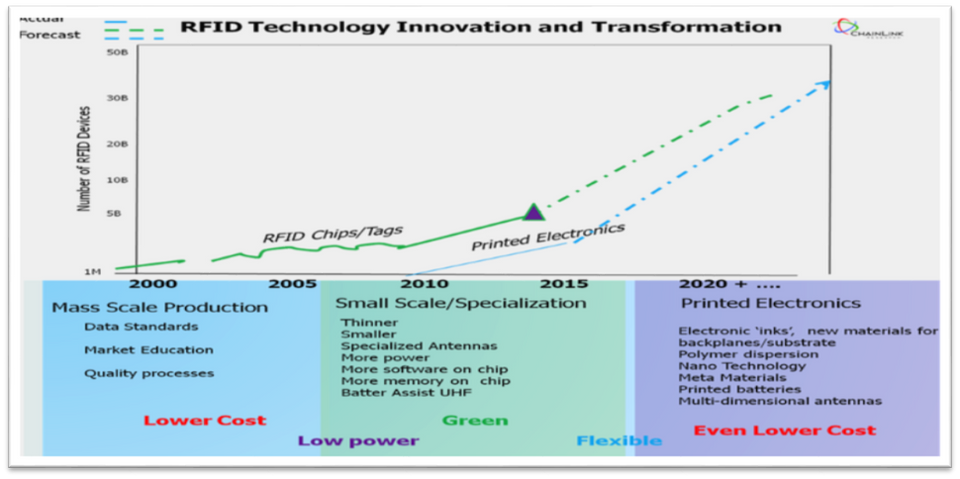
Future of RFID
The future of electronics, RFID and antennas is quite interesting.1 Material innovations in organic polymers, Nano technology, meta materials; and innovations in processing such as advances in photolithography, electron-beam lithography, direct laser/optical lithography, electrophoretic; new battery/power technologies—the whole area of printed electronics on organic new material, cloth and paper, all are in motion to step by step transform the semiconductor world. More flexible and cheaper production will enable a new generation of RFID growth.

Slide 19
Conclusion
It is an another TECH REVOLUTION which will change our lives completely And it will be used 24/7days.
The billion dollar industry that RFID has evolved into has done great good for a lot of different fields. RFID has given doctors the ability for quick access to patients records, the assurance of accounted merchandise for small business and large alike, and the government the ability to conduct taxes for tolls in this technological day and age. But with as many benefits as it has, Radio Frequency Identification's overwhelming credibility is balanced out by the criticism against it.
Though RFID allows for the allocation and distribution of sensitive information, if that information is compromised, the effects could be devastating. For there to be order in the realm of RFID, legislation and guidelines need to be set up and enforced to ensure the integrity and confidence of the data being communicated, which will in turn help Radio Frequency Identifications emerge as more secure and advanced.

Slide 20
Thank You

